Slide 1

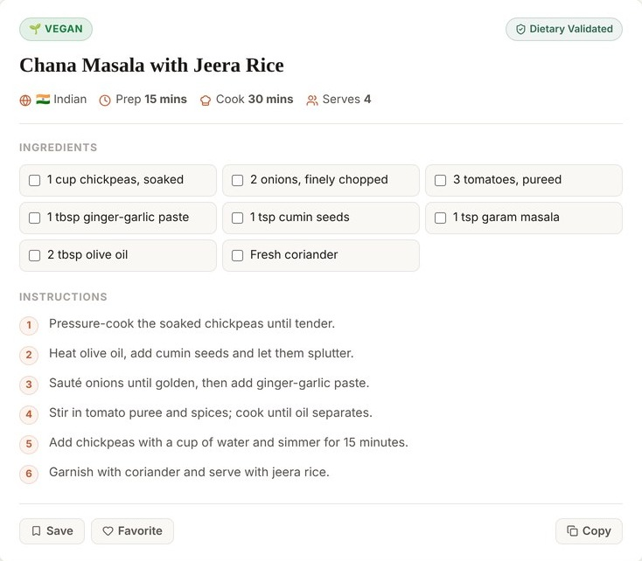


A personalized food and diet assistant using a fine-tuned small language model
Cook what you have. Eat the way you live.
KM Sreenidhi
CSE (AI & ML), Woxsen University
BUILT FOR
Notes:
Nourish SLM turns the ingredients you have into a complete recipe that fits your diet and avoids your allergens, shows its nutrition per serving, and builds full-day diet plans for 24 goals and sports. It runs on a fine-tuned Qwen3-4B with rule-based safety checks.

Slide 2










Chatbots guess. Nobody checks the diet.
PROBLEM STATEMENT AND OBJECTIVES
Never checks diet or allergies
Ghee for a vegan, peanuts for anyone
No nutrition facts
Calories and protein are a guess
No plan for your goals
Nothing built around training
Costly, not private
Paid cloud APIs see your data
A generic chatbot, asked for a vegan dinner
WHAT WE SET OUT TO BUILD
Fine-tune Qwen3-4B
Check diet + allergies
Nutrition per serving
Plans for 24 goals
Beat the base model
Run fully local

Slide 3
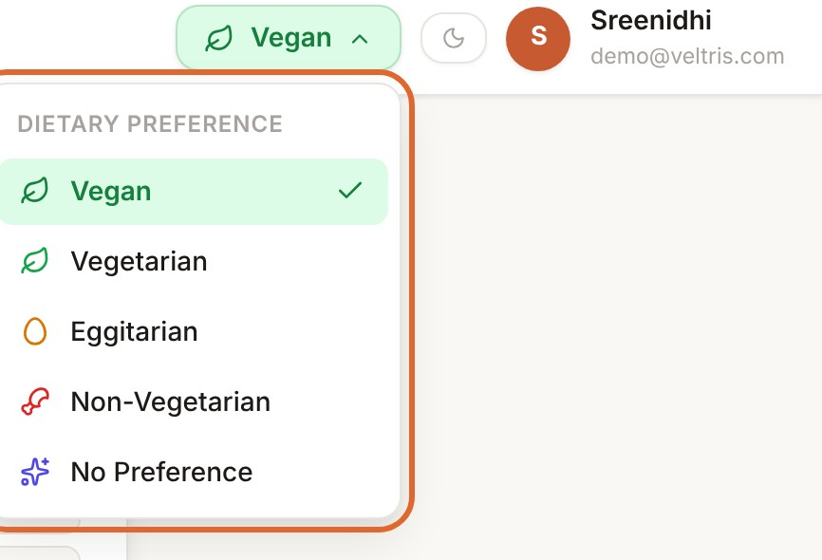
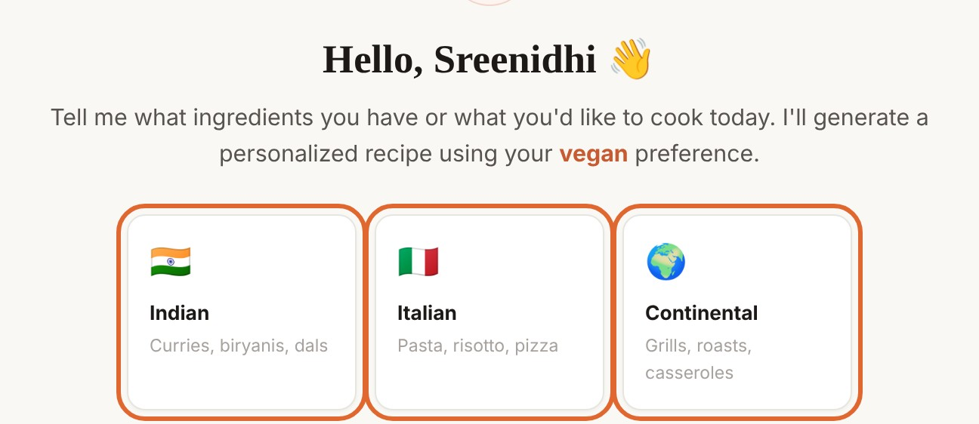
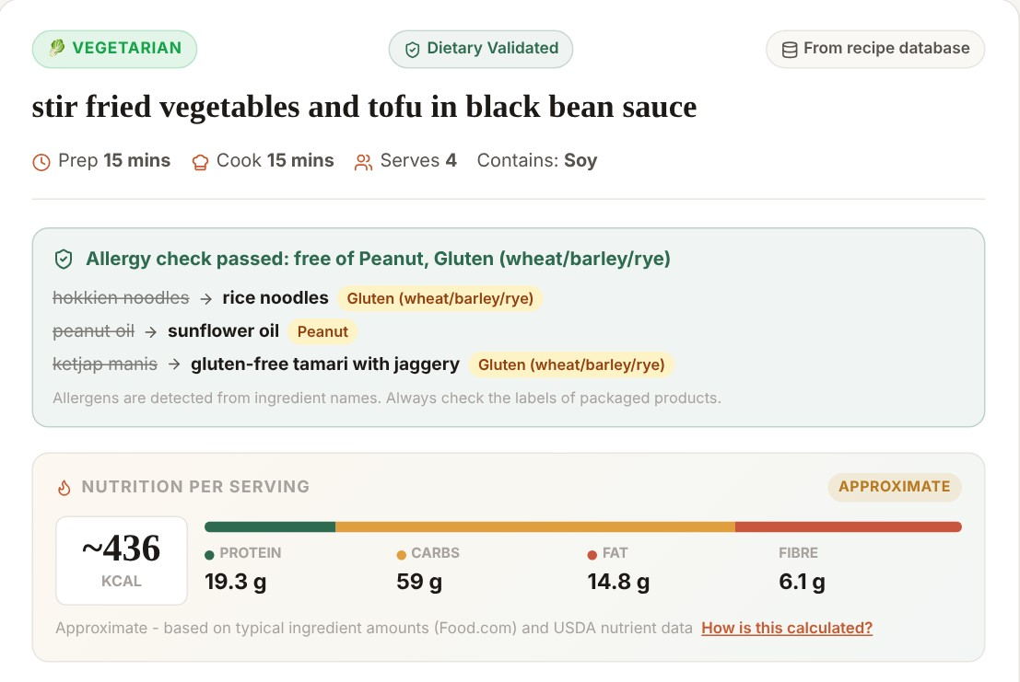
Your kitchen in. A recipe that fits you out.
PROPOSED SOLUTION
1
Pick diet + allergies
2
Say what you have
3
Get a checked recipe
Fine-tuned SLM
Diet + allergy checks
Nutrition per serving
24 diet plans

Slide 4










The model writes. The validator decides.
SYSTEM ARCHITECTURE AND WORKFLOW
React UI
chat, diet, plans
FastAPI
JWT auth, REST
Preferences
diet, allergies
Retrieval
229,168 recipes
SLM inference
Qwen3-4B + LoRA
Recipe card
shown to user
JSON recipe
tagged by source
Nutrition
USDA, per serving
Allergy check
10 allergens
Diet validator
rules + swaps
saved
if output unusable
Diet planner
24 plans + assistant
Database
users, chats, plans
Recipe data
46,514 diet recipes
Three-tier fallback
model → retrieved recipe → template
Nothing reaches the user unchecked
Notes:
A request goes from the React app to FastAPI, picks up the user diet and allergies, retrieves similar recipes and asks the fine-tuned model for a JSON recipe. The diet validator, the allergy checkpoint and the nutrition engine then run in order before the card is shown. The Diet planner reuses the same nutrition engine and diet rules on 46,514 recipes.

Slide 5
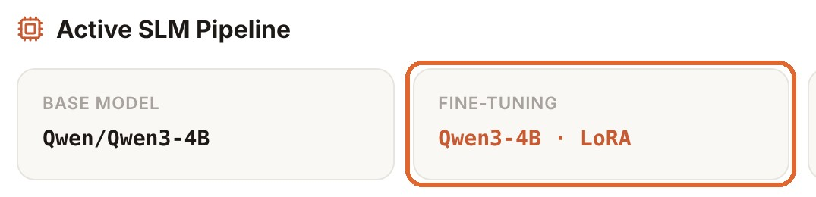
229,168 recipes taught Qwen3-4B to cook
DATASET AND FINE-TUNING
229,168
6,000
55 min
132 MB
Food.com recipes, cleaned
balanced training examples
375 steps on one RTX 4070
LoRA adapter on Qwen3-4B
Live in the app
QLoRA recipe
4-bit base
r 16 · α 32
all 7 projections
lr 2e-4
1 epoch
batch 16

Slide 6
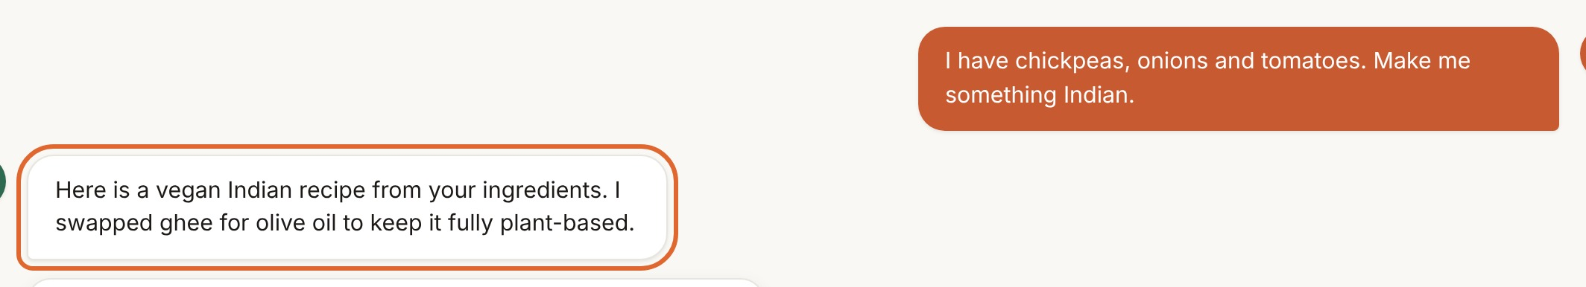
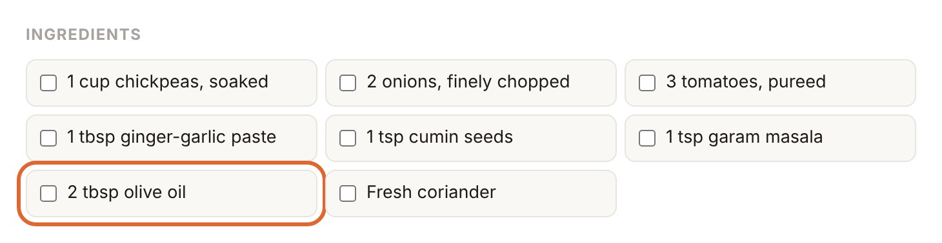
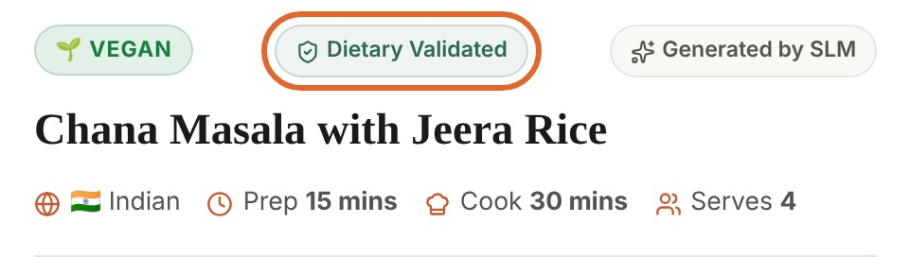
Ghee in a vegan dish? Caught and swapped.
DIETARY SAFETY LAYER
Model
suggests
ghee
dairy ✗ vegan
olive oil
plant ✓
Diet | Meat | Egg | Dairy | Plant
Vegan | ✗ | ✗ | ✗ | ✓
Vegetarian | ✗ | ✗ | ✓ | ✓
Eggitarian | ✗ | ✓ | ✓ | ✓
Non-veg | ✓ | ✓ | ✓ | ✓
What the user sees
50 / 50
0.1 ms
test cases pass
per safety check

Slide 7
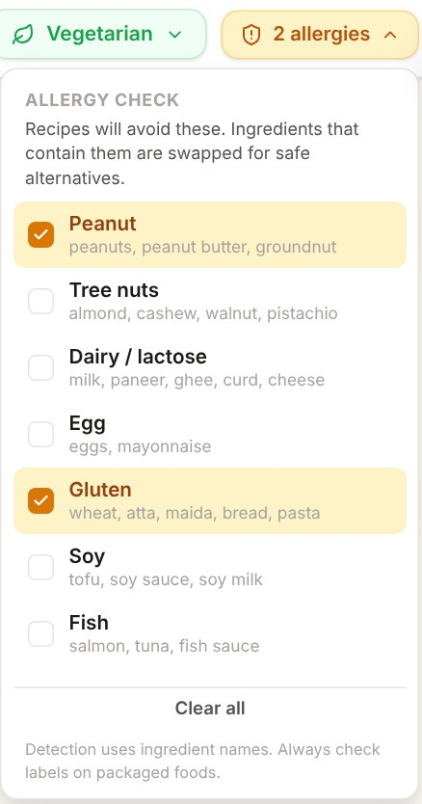
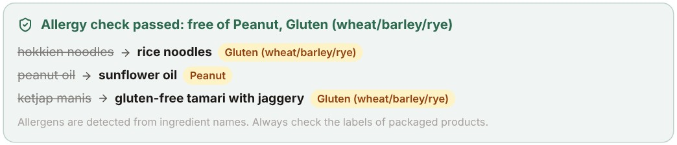
Tick your allergies. Every recipe is made safe.
ALLERGY CHECKPOINT
What the user sees
10
allergens checked on every recipe
Peanut
Tree nuts
Dairy
Egg
Gluten
Soy
Example swaps
Fish
Shellfish
peanut oil
sunflower oil
Peanut
Sesame
Mustard
hokkien noodles
rice noodles
Gluten
Swaps never add another of your allergens, and the steps are rewritten to match.
Anything that cannot be swapped gets a clear warning.
paneer
firm tofu (or chickpeas)
Dairy
almond milk
oat milk
Tree nuts
Notes:
Users pick allergies in the chat header; the list is saved to their profile. Every recipe is checked against it. Each allergen ingredient is swapped for the first alternative that does not contain another of the user allergens, so paneer becomes tofu, or chickpeas if the user is also allergic to soy. The steps and title are rewritten in one pass, and the card lists every change. Detection uses ingredient names, so the app always asks users to check packaged-food labels.

Slide 8
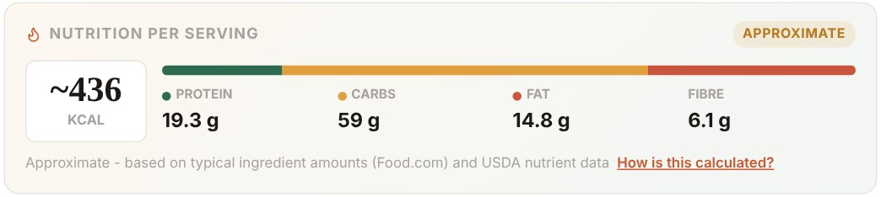
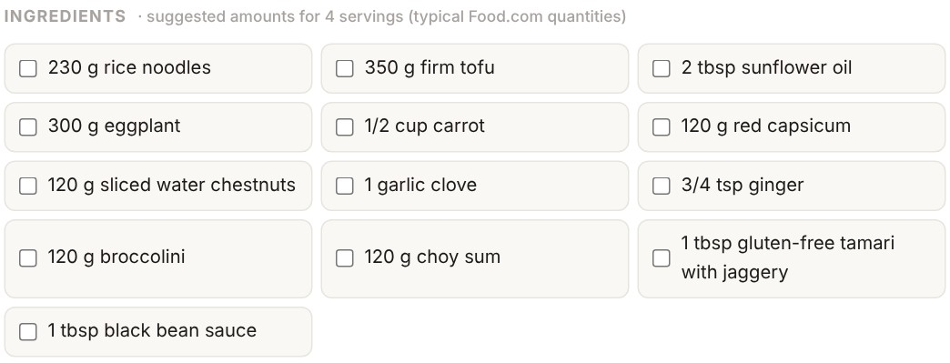
Calories and macros on every recipe card
NUTRITION ON EVERY RECIPE
Per serving, on the recipe card
Dataset recipes
Published Food.com nutrition per serving, labelled Recipe data
Model-written recipes
The model lists ingredients without amounts, so:
With suggested amounts for every ingredient
1
Typical amount per ingredient: the median real Food.com recipes use
2
Nutrient values from USDA FoodData Central
3
Divided by servings and labelled Approximate
5
1,071
7,805
nutrients per serving
typical amounts
USDA foods
Notes:
Every chat recipe now shows calories, protein, carbohydrate, fat and fibre per serving. Recipes from the dataset use their published values. Recipes the model writes have no amounts, so each ingredient gets the median amount real Food.com recipes use, shown to the user as a suggested quantity, and the nutrition is calculated from USDA FoodData Central and clearly labelled approximate. Ingredients with no USDA match are listed rather than guessed.

Slide 9
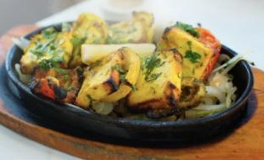
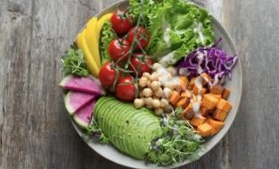
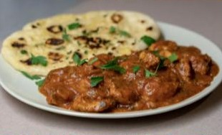
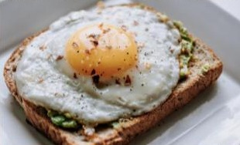
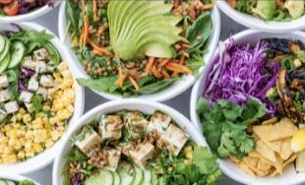
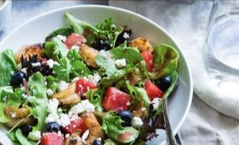

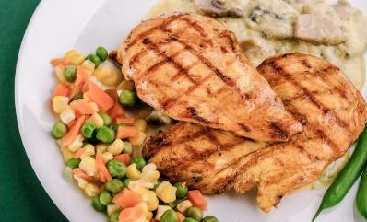
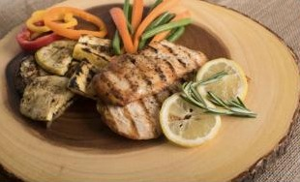
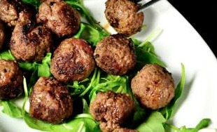
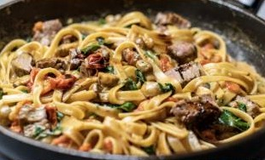


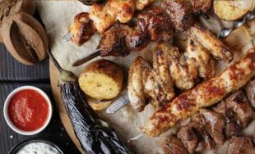
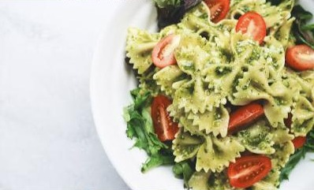

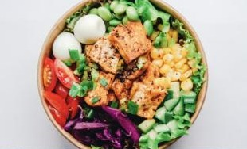
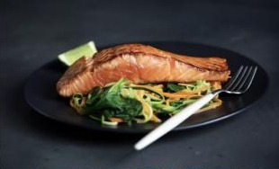


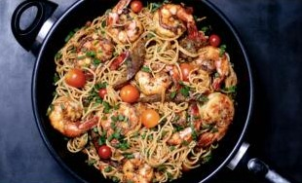

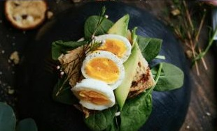
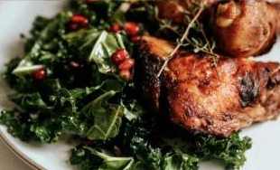
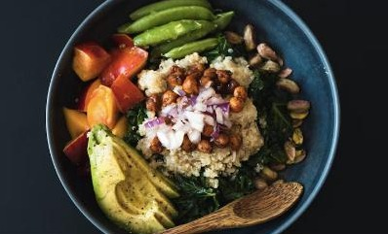
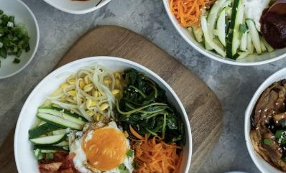


24 diet plans, built from 46,514 real recipes
DIET SECTION
46,514
Vegetarian
Vegan
Non-veg
Eggetarian
Balanced
Weight loss
plan-ready recipes with photos and nutrition
Targets from your own details
Weight gain
Muscle
High protein
Low carb
Endurance
Recovery
Energy: Mifflin-St Jeor × activity level
Cricket
Football
Basketball
Tennis
Badminton
Swimming
Protein 1.2–2.2 g/kg by goal (ACSM, ISSN)
Carbs by training load (ACSM 2016)
Running
Cycling
Gym
Bodybuilding
Yoga
Other sports
Meals timed around your training
5 diet preferences
7 fitness goals
12 sports
Notes:
The Diet section has 24 plans: five dietary preferences, seven fitness goals and twelve sports. Plans are built from 46,514 Food.com recipes that have photos, instructions and published nutrition, each re-checked for diet and allergens from its ingredients. Targets come only from what the user enters: Mifflin-St Jeor energy, and protein and carbohydrate ranges from ACSM 2016 and ISSN 2017 guidance.

Slide 10
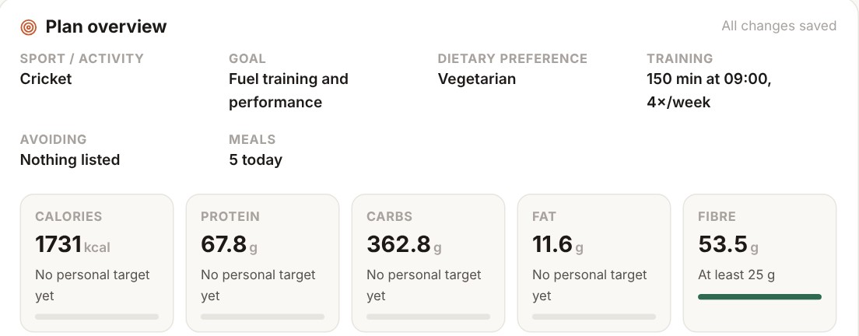
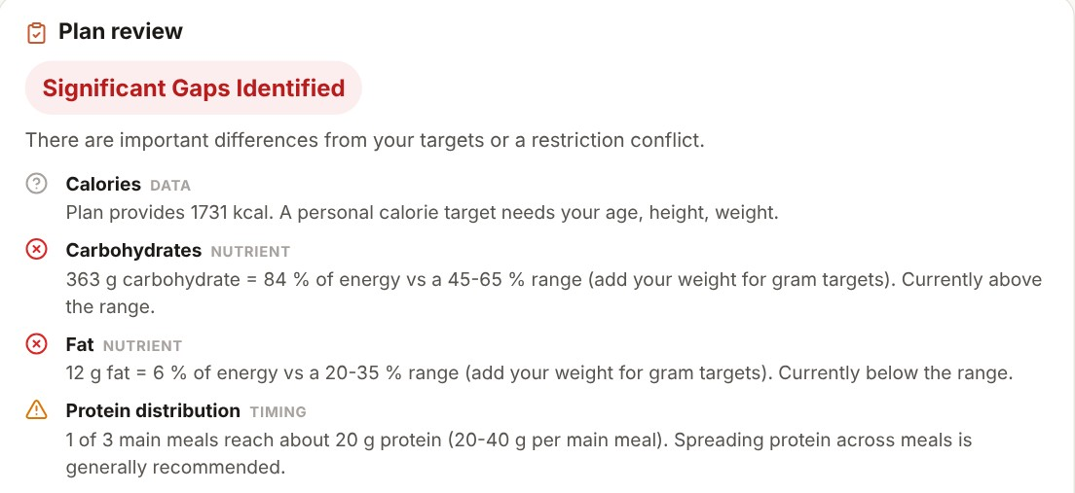
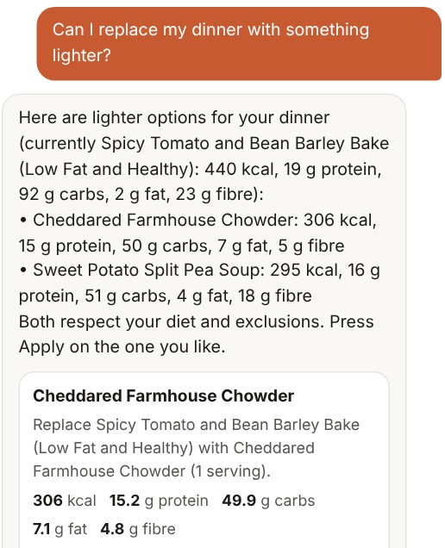
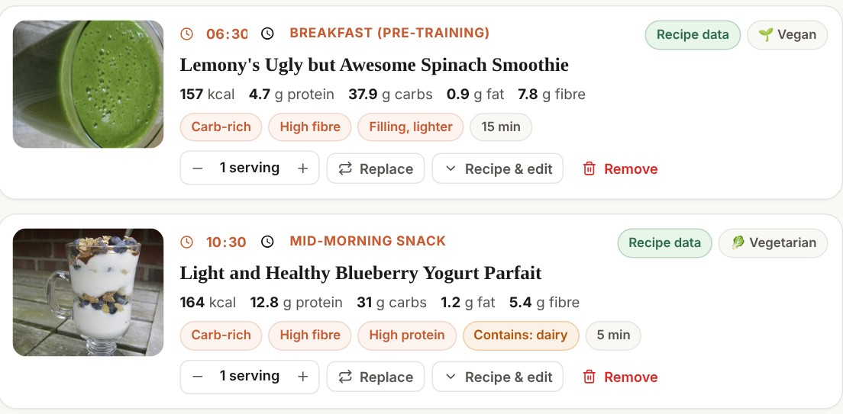

A day of meals, checked, with its own assistant
DIET PLANS
1
A full day of meals
2
Check My Diet
3
Plan assistant
Restriction: a diet, allergy or dislike conflict
Nutrient gap: calculated against your targets
Data and timing: pre- and post-training meals
Changes are proposals: the plan updates only when you press Apply
Notes:
Opening a plan gives a full day of meals timed around training, with daily totals. Every meal and ingredient can be edited, and nutrition is recalculated. Check My Diet reviews the plan against the user targets and labels each finding as a restriction, a nutrient gap, or a data and timing issue, with one overall label rather than a score. Each plan has its own assistant that answers from that plan only; changes come back as a preview and are applied only when the user presses Apply. Free-form answers reuse the same Qwen3-4B with the adapter disabled, and any invented figures are removed.

Slide 11

























An open-source stack, end to end
TECH STACK
Frontend
React 19
TypeScript
Vite
Axios
Backend
Python 3.12
FastAPI
SQLAlchemy
Pydantic
JWT + bcrypt
AI / ML
Qwen3-4B
PyTorch
Transformers
LoRA / QLoRA
Pandas
Jupyter
Data
SQLite
PostgreSQL
Food.com
USDA FDC
Deploy
Apple MPS
NVIDIA CUDA
Docker
Nginx
GitHub

Slide 12
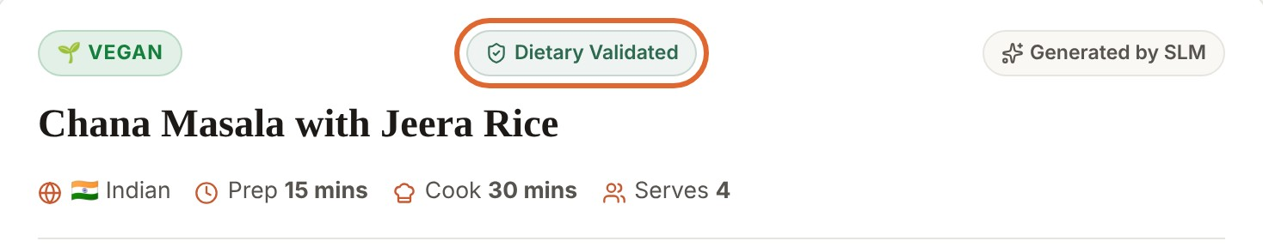
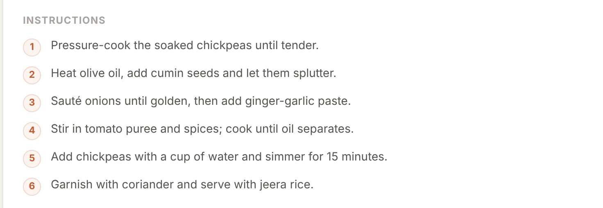
62% lower error. 97% complete recipes.
RESULTS AND EVALUATION
−62%
6×
97%
100%
test loss (2.895 → 1.106)
lower perplexity (18.1 → 3.0)
complete recipes (was 66.7%)
diet compliance, kept
97% of answers look like this

Slide 13
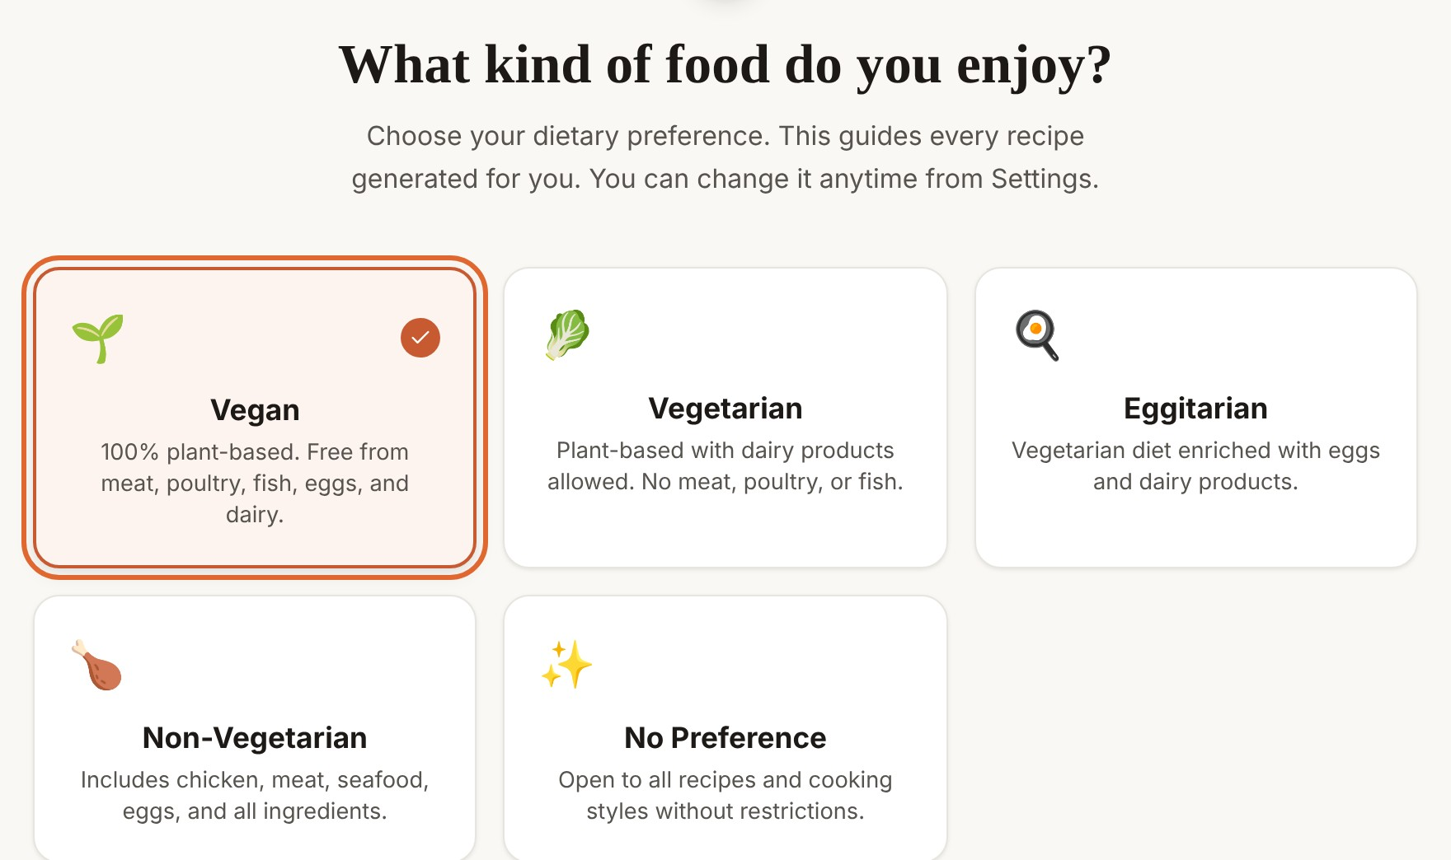
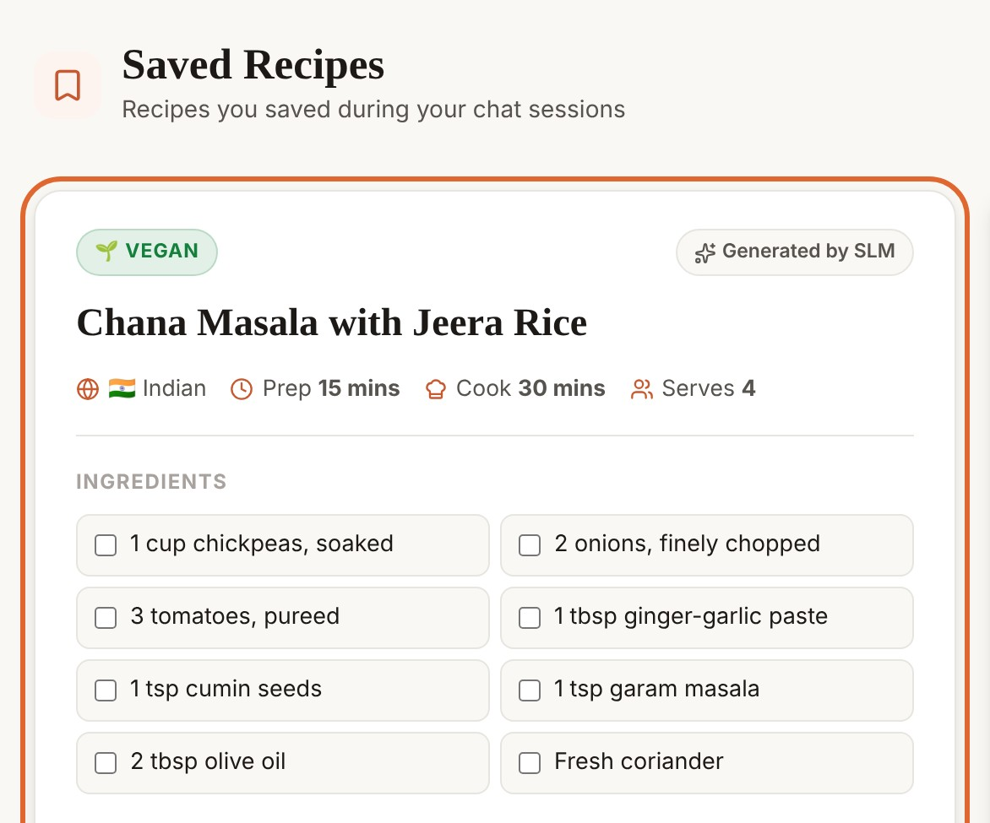
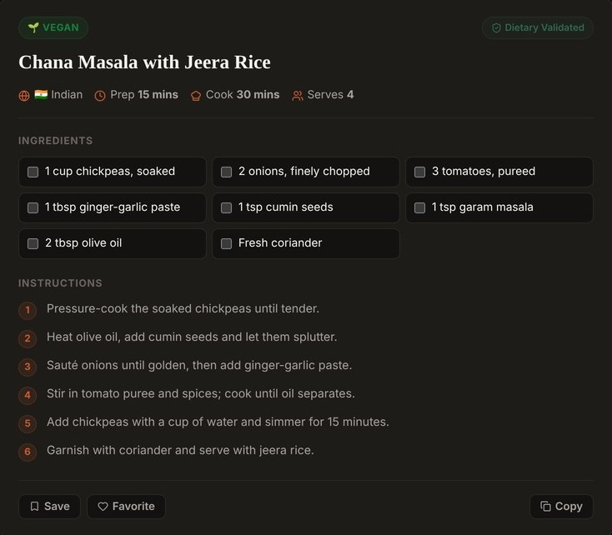



From picking a diet to saving a recipe
APPLICATION AND DEPLOYMENT
1
Pick your diet once
2
Save what you like
3
Light or dark theme
Local Mac
GPU server
Docker
./run_on_mac.command
Uvicorn + Nginx, HTTPS
docker compose up

Slide 14





Smarter recipes, safe by design
CONCLUSION AND FUTURE SCOPE
Next up
Hidden ingredients in packaged foods
Working product
Fine-tuning works
Recipes, nutrition and 24 diet plans
Loss −62%, complete recipes 97%
Bigger training run
Faster quantized inference
More Indian recipes
Safe by design
Private and tested
Mobile app and reminders
Diet and 10 allergens checked
Runs locally · 73 tests pass
github.com/sreenidhi-km/nourish-slm
References: Qwen3 Technical Report (2025) · Hu et al., LoRA (2022) · Dettmers et al., QLoRA (2023) · Majumder et al., Food.com (2019) · USDA FoodData Central (2018) · Thomas et al., ACSM (2016)

Slide 15

Thank you
Questions are welcome
github.com/sreenidhi-km/nourish-slm
KM Sreenidhi · CSE (AI & ML), Woxsen University
BUILT FOR

